Slide 1
Artifact reduction in LED-based photoacoustic imaging using deep learning (U-net)
Hongshuo Wang

Slide 2
Issue
Lacking of high performed GPU: took me above 7 hours to train each model
Solved : purchased GTX 3070 graphic card a week ago
Different versions of Unets: besides in our paper, there are couples of versions of Unets on the Internet
Solved: train 3 different versions of Unets then comparing each results

Slide 3
Model v1
Fully implemented the model described in the paper
Structure:
20 3x3 conv layers
64,128,256,512,1024 layers encoder
64,128,256,512,1024 layers decoder
4 2x2 maxpool layers
4 concatenate layers
5 upsampling layers
20 batch normalization layters
Loss function: mean squared error
Optimizer: RMSprop
Total parameters: 31,438,529

Slide 4
Model v2
Fully implemented the model described in the original Unet paper
Using up-conv instead of upsampling
Structure:
20 3x3 conv layers
64,128,256,512,1024 layers encoder
64,128,256,512,1024 layers decoder
4 2x2 maxpool layers
4 concatenate layers
5 2x2 up-conv layers
20 batch normalization layters
Loss function: mean squared error
Optimizer: RMSprop
Total parameters: 31,091,329

Slide 5
Model v3
My opinion:
The artifacts in each image are small and similar dots. In my experience, those dots can use light-weights model to solve
More parameters -> more complex -> less variance
Structure:
20 3x3 conv layers
16,32,64,128,256 layers encoder
16,32,64,128,256 layers decode
4 2x2 maxpool layers
4 concatenate layers
5 upsampling layers
20 batch normalization layters
Loss function: mean squared error
Optimizer: RMSprop
Total parameters: 1,968,225

Slide 6
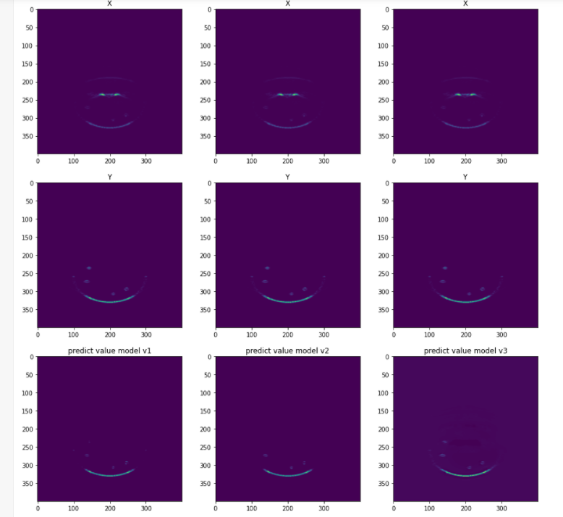
Results

Slide 7
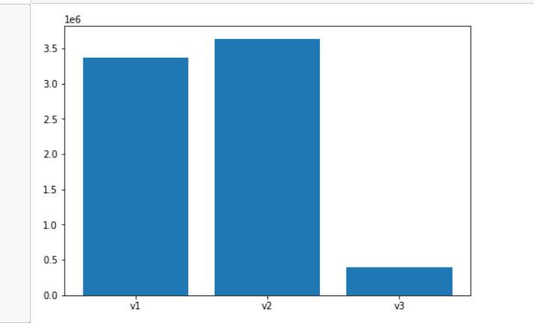
Loss comparison

Slide 8
Reference
https://github.com/nikhilroxtomar/UNet-Segmentation-in-Keras-TensorFlow
https://github.com/zizhaozhang/unet-tensorflow-keras
https://github.com/zhixuhao/unet

